Slide 1
Search and Sets Functionality in Alma
Yoel Kortick
Senior Librarian

Slide 2

Agenda
Introduction
Manage List of Sets via Facets
Top List Actions
Clear Information Hierarchy
Responsiveness to screen size and resolution
Split View (Side-By-Side View)

Slide 3
Introduction

Slide 4
Introduction
In addition to this presentation see also Managing Search Queries and Sets.

Slide 5
Manage List of Sets via Facets

Slide 6
Manage List of Sets via Facets
The presentation of the various facets while viewing the list of sets enables the user to search for sets in a unified and efficient manner.
After selecting “Admin > Manage Jobs and Sets > Manage Sets" a list facets will appear.
These facets allow the staff user to view all sets which have a particular property in common.

Slide 7
Manage List of Sets via Facets
The facets include:
  Type
    Either “Itemized” or “Logical”
  Content Type
    See Set Content Types
  Content Origin
    Either “Institution only” or “Discovery”.
    For member institutions of a network zone the Content Origin can also be “Network and institution”

Slide 8
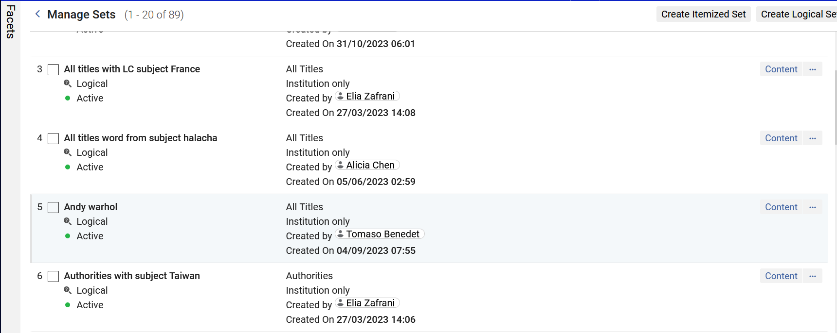
Manage List of Sets via Facets
“Facets” on the “Manage Sets” page
By default, the facet pane is collapsed. Click the lane to open it.

Slide 9
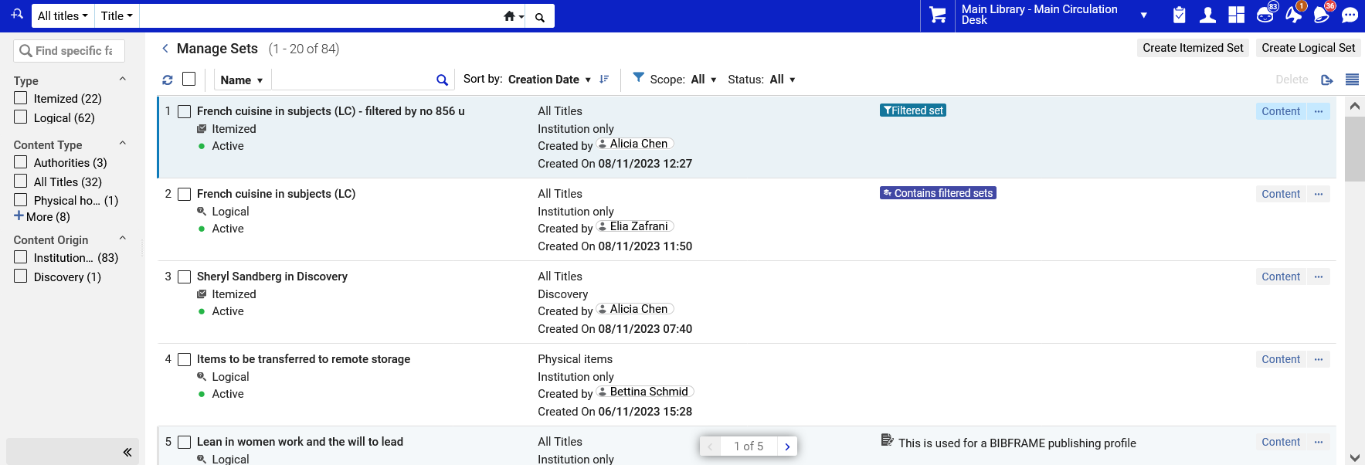
Manage List of Sets via Facets
The facet pane is now open (not collapsed).
Click here to collapse the plane

Slide 10
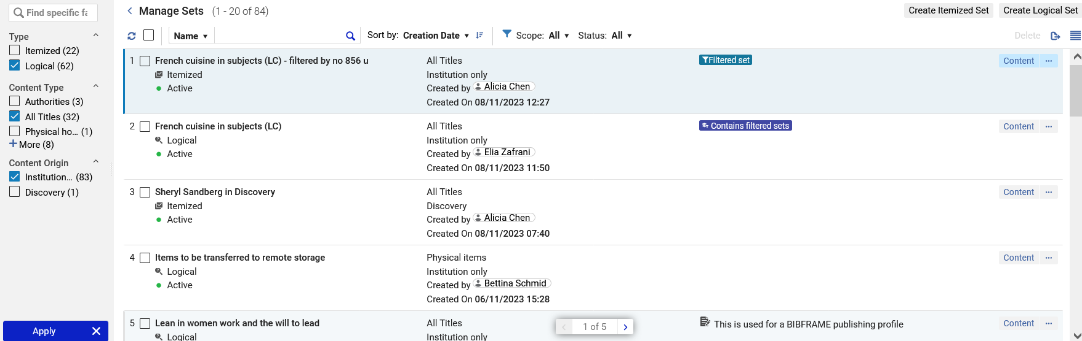
Manage List of Sets via Facets
Now we will facet by all sets with type “Logical” with Content Type “All Titles” and Content Origin “Institution only”. Note that this is “Multi-Select Facets”.

Slide 11
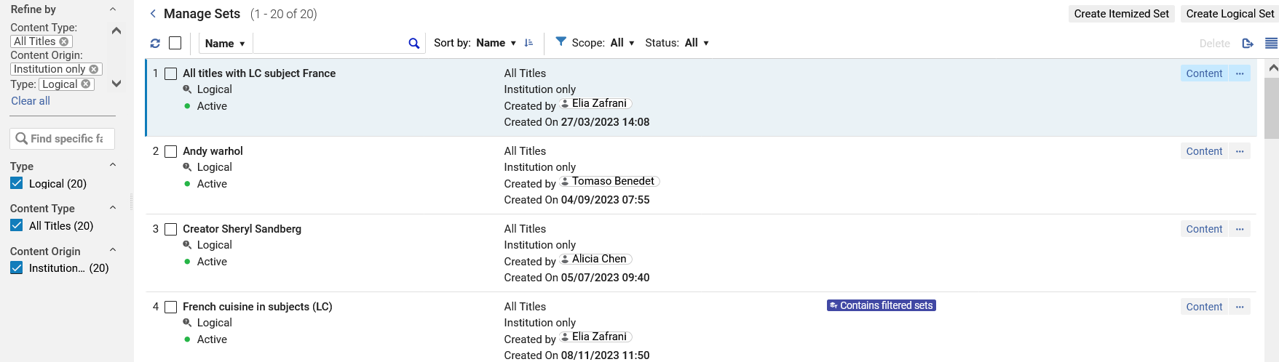
Manage List of Sets via Facets
All sets in list are now type “Logical” with Content Type “All Titles” and Content Origin “Institution only”

Slide 12
Manage List of Sets via Facets
The list of sets has been faceted and we can either remove specific facets (by clicking the “x” next to the facet) or “Clear all” facets

Slide 13
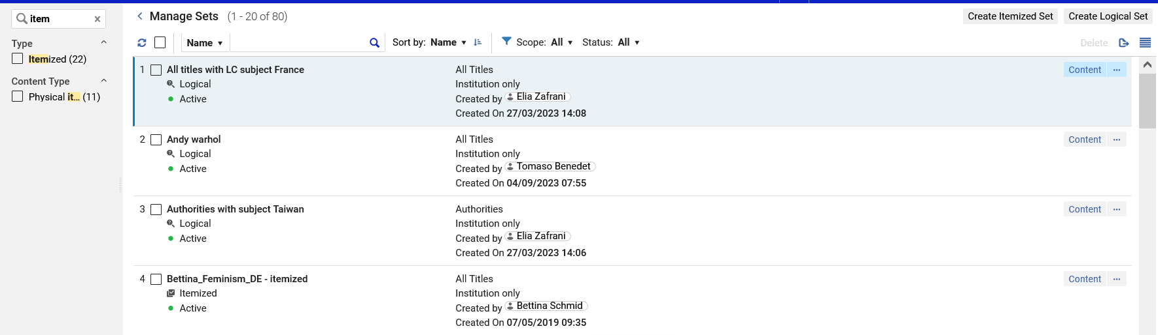
Manage List of Sets via Facets
When searching for facet values it is possible to perform a textual search rather than scrolling through all of the values.

Slide 14
Top List Actions

Slide 15
Top List Actions
In addition to the facets, the list of sets can be further filtered using the “Top List Actions”. This includes:
Search
  By all or part of the name of the set
  By Primary Identifier of staff user who created the set
Sort (ascending or descending)
  By name of set
  By creation date of set
Scope
  All sets
  Public sets
  My sets
Status
  All
  Inactive
  Active

Slide 16
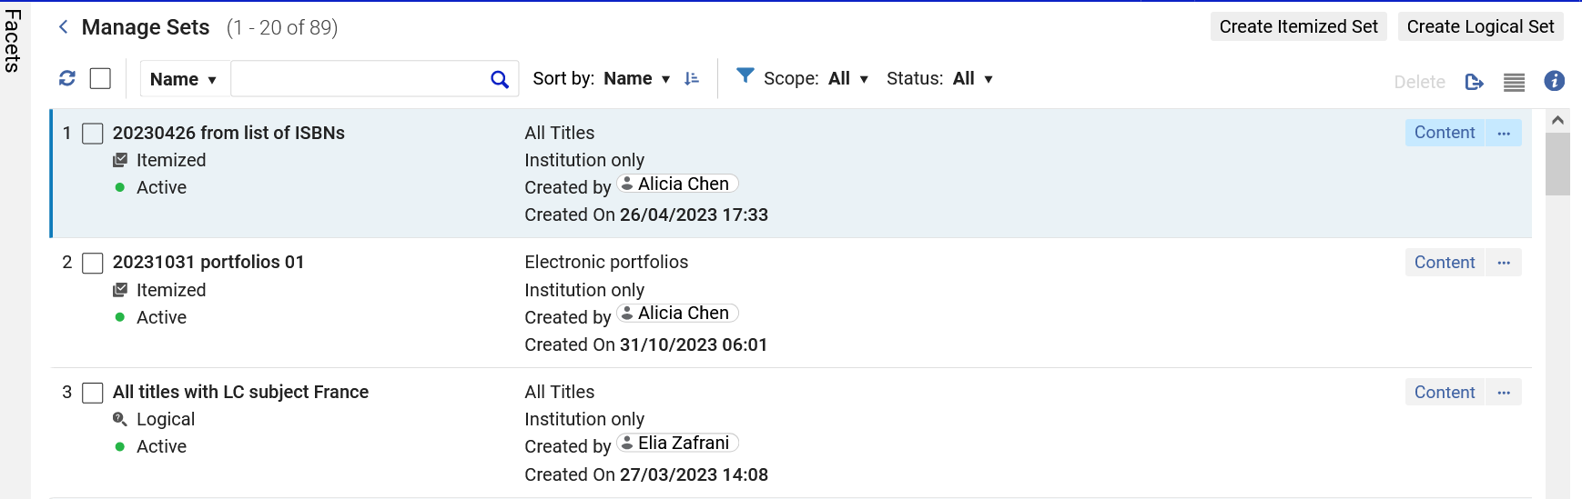
Top List Actions

Slide 17
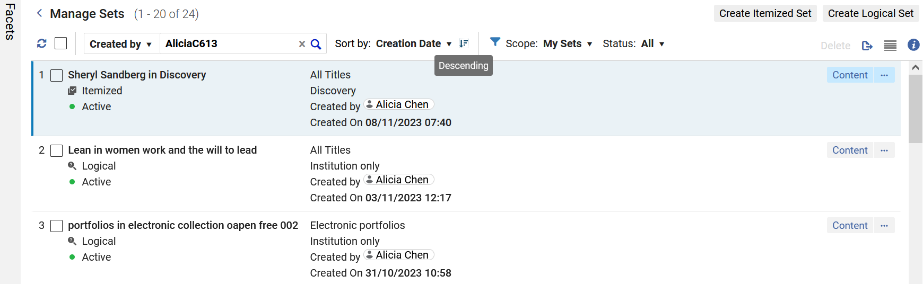
Top List Actions
Here for example, we have all sets created by staff user Alicia Chen sorted descending by Creation Date

Slide 18
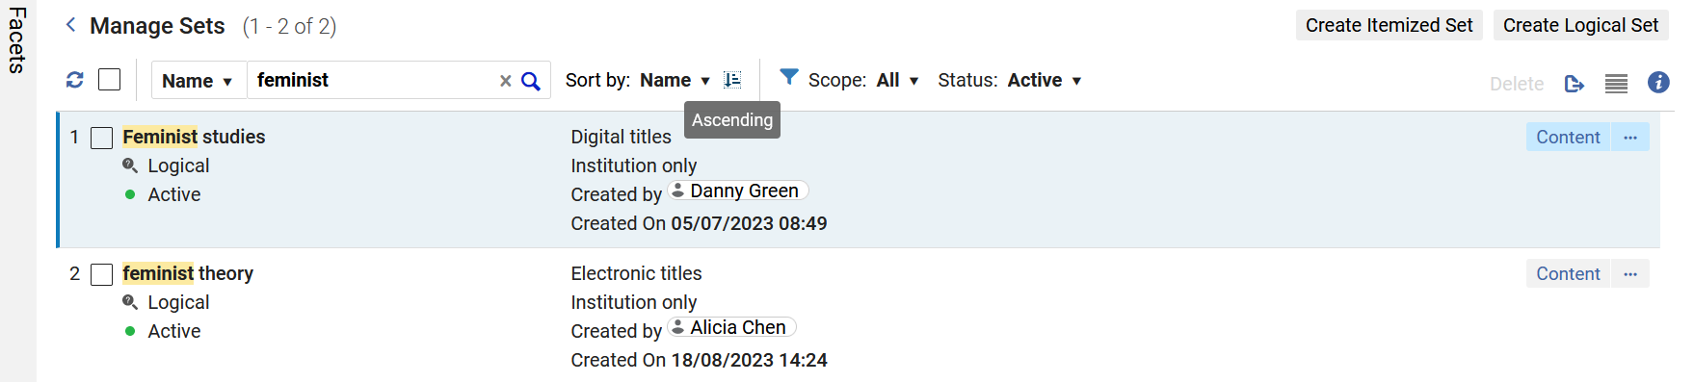
Top List Actions
Here for example are all Active sets with the word “Feminist” in the name, sorted ascending by name.

Slide 19
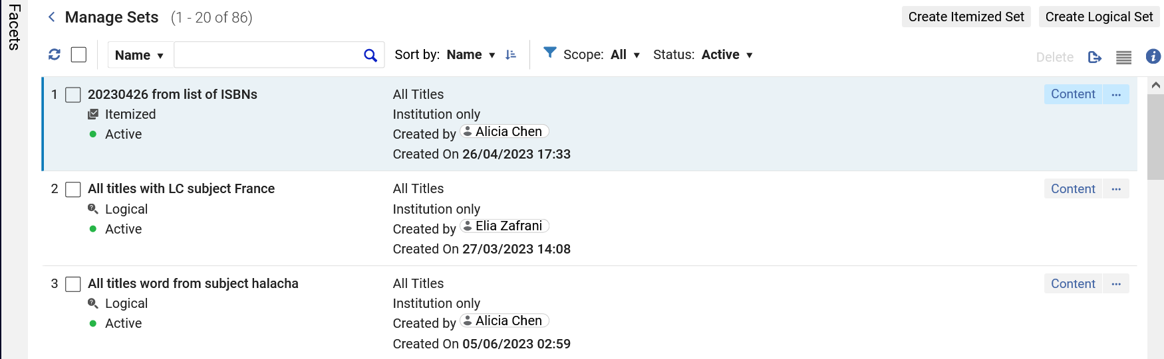
Top List Actions
The “Delete” option is “Action Sensitive”.
It will be non active unless sets (to delete) are chosen
Now the “Delete” option is not active because no sets have been chosen to delete.

Slide 20
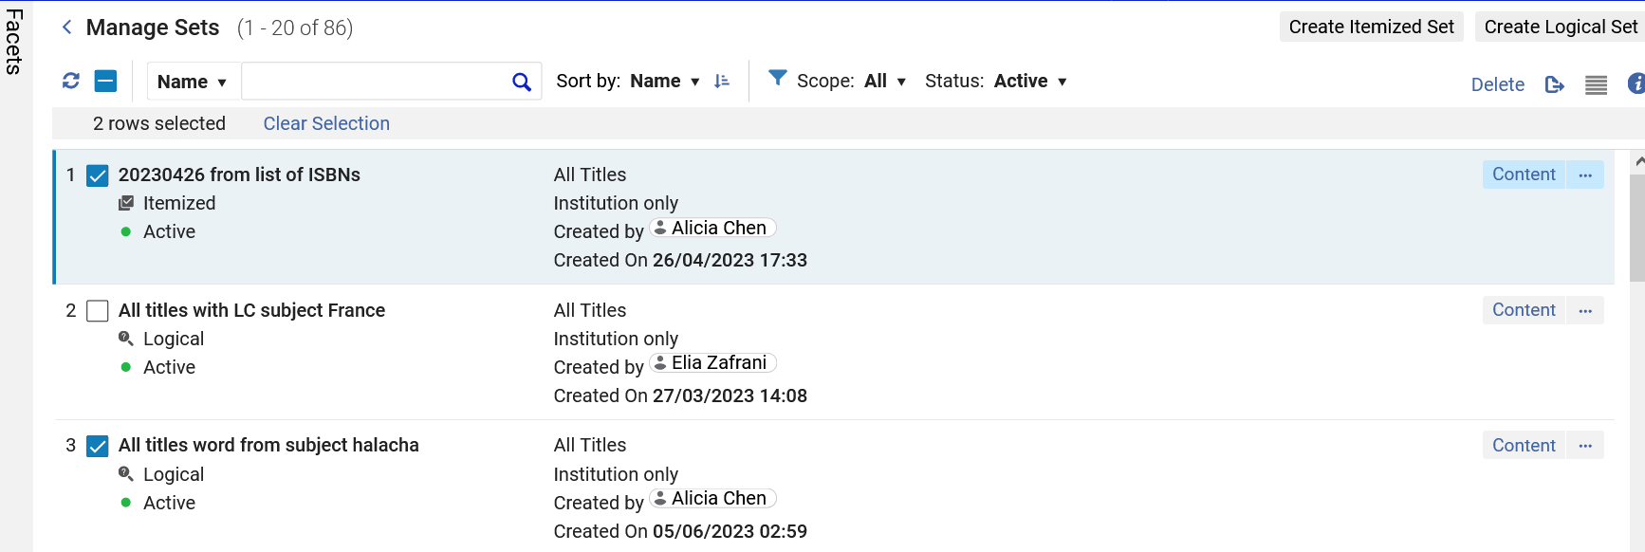
Top List Actions
Now the “Delete” option is active because sets (to delete) have been chosen
The “Delete” option will delete the sets in bulk. In this case two sets would be deleted.

Slide 21
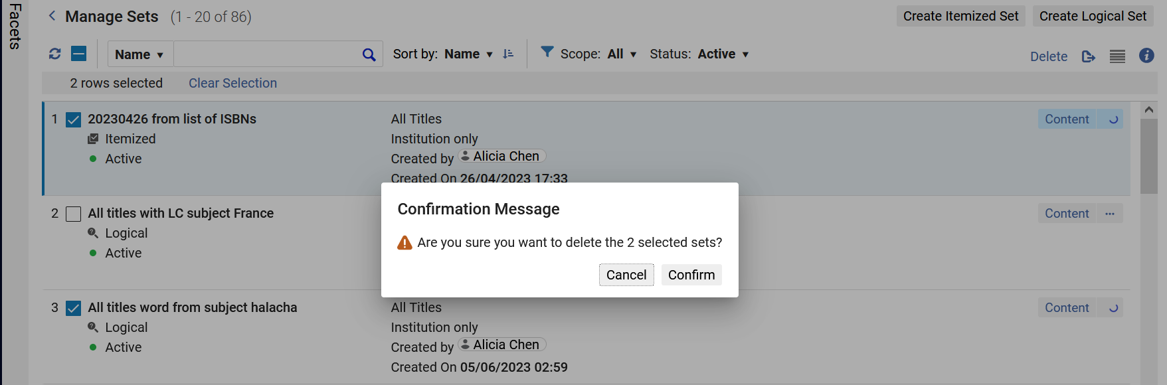
Top List Actions
This is the confirmation message after clicking delete.

Slide 22
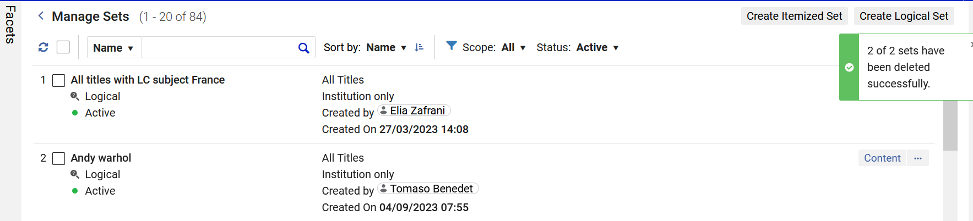
Top List Actions
After clicking “Confirm” in the confirmation message the two sets are deleted.

Slide 23
Clear Information Hierarchy

Slide 24
Clear Information Hierarchy
The list of sets in the “Manage Sets” page contains a clear and prominent information hierarchy of the sets facet and search results.
This enables staff users who are reviewing the sets to find what they need quickly and with minimal navigation needs.

Slide 25
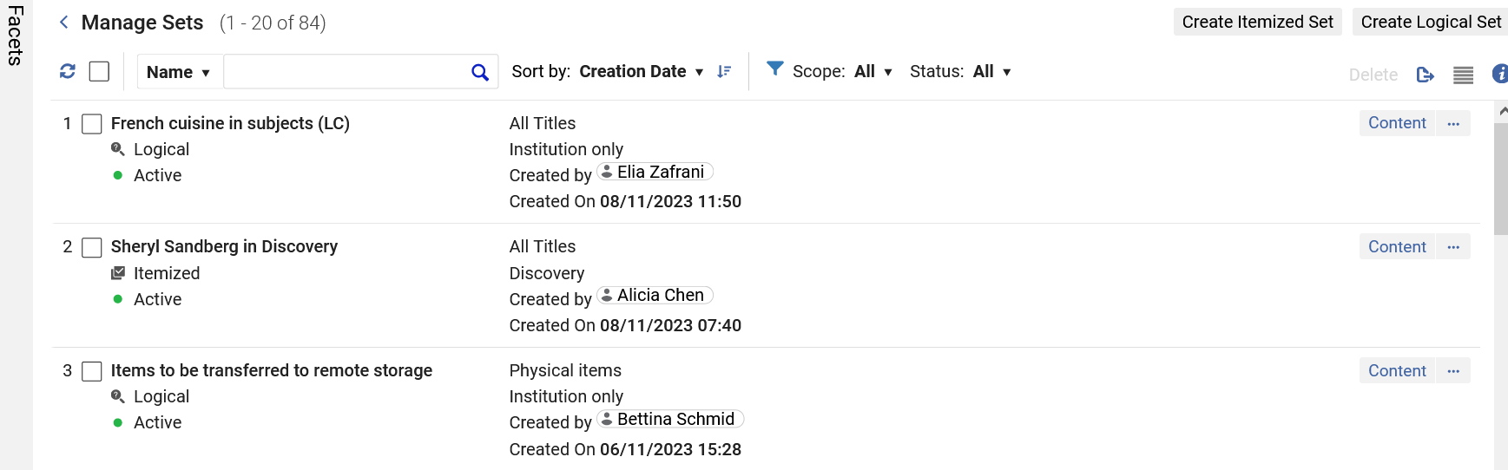
Clear Information Hierarchy
Staff user can quickly and easily identify…
Who created the set and when
What the “Content origin” is
What the “Set content type” is
If the set type is “Logical” or “Itemized”
Which records are contained in the set

Slide 26
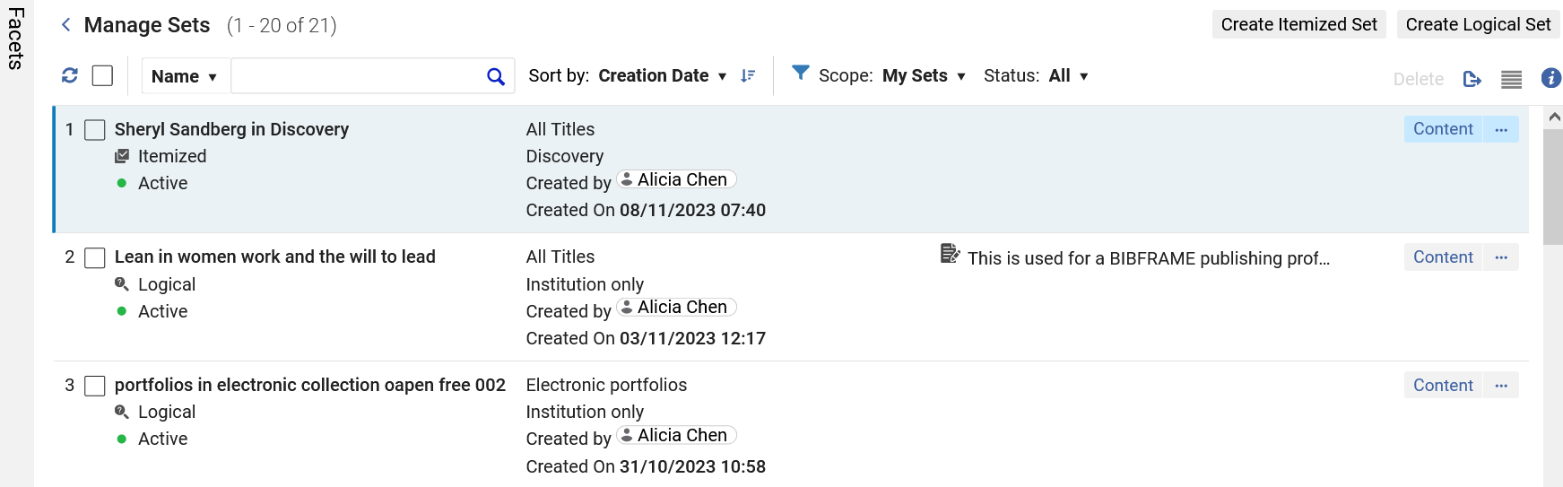
Clear Information Hierarchy
If the set has an internal note, then it will prominently display in the list

Slide 27
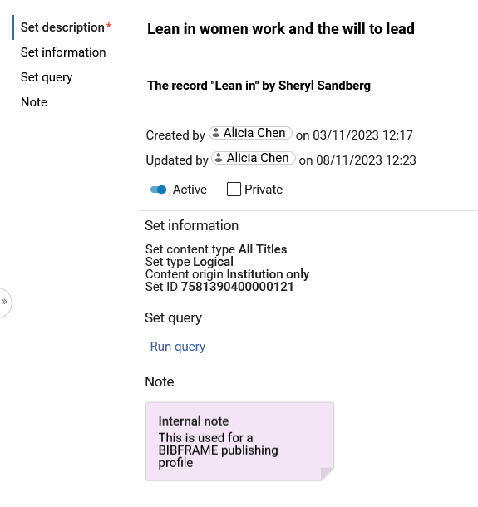
Clear Information Hierarchy
Here is the internal note in the set

Slide 28
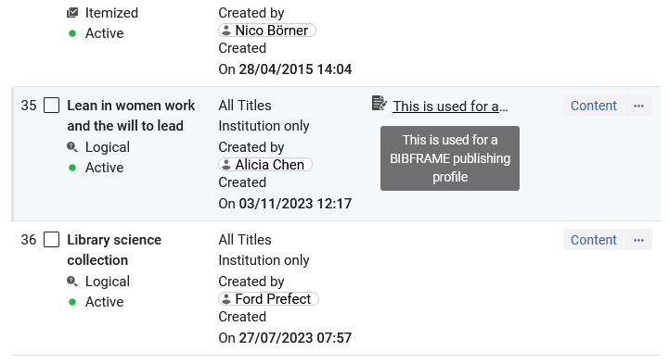
Clear Information Hierarchy
If the entire text of a note does not appear in the list view, then hovering over the note will show the entire text.

Slide 29
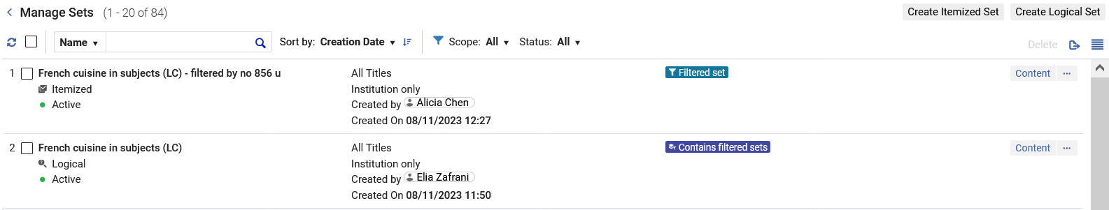
Clear Information Hierarchy
If the set is a “Filtered set” or “Contains filtered sets” , then it will prominently display in the list with a “badge”.
For more information about filtering sets with an indication rule see Filtering Sets

Slide 30
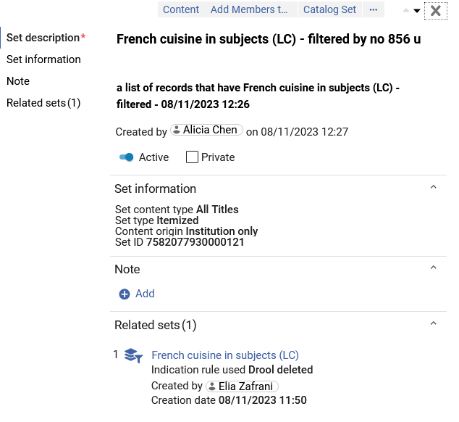
Clear Information Hierarchy
This is the “Filtered set”

Slide 31
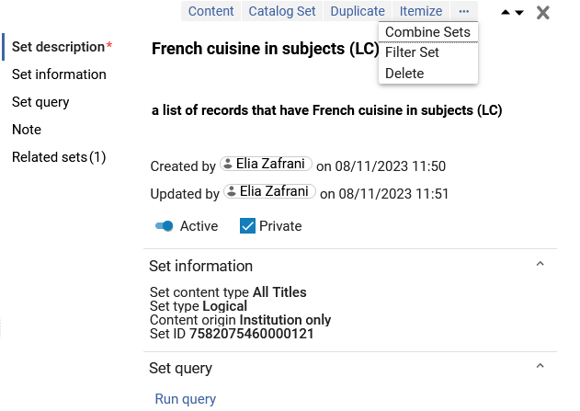
Clear Information Hierarchy
In the previous example of “Filtered set” and “Contains filtered sets”, the sets were created as follows: We opened set “French cuisine in subjects (LC)” and did “Filter set” and chose an indication rule to filter the set.

Slide 32
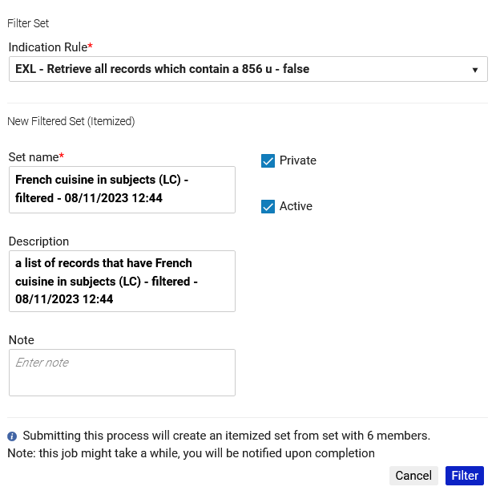
Clear Information Hierarchy
This is how we filtered the set.

Slide 33
Responsiveness to screen size and resolution

Slide 34
Responsiveness to screen size and resolution
The responsiveness to screen size and resolution causes Alma to display data differently (more appropriately) depending on the size and resolution of the screen.
While this has been added to much of the new Alma UI, we will look at some examples here for the “Manage Sets” screen accessed at “Admin > Manage Jobs and Sets > Manage Sets”
We will see more example of “responsiveness to screen size and resolution “ when we look at “Split View (Side-By-Side View)”

Slide 35
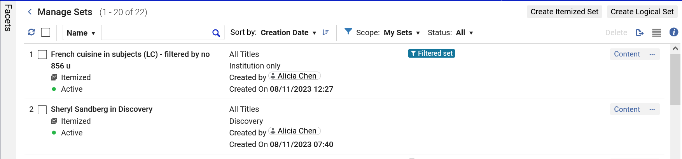
Responsiveness to screen size and resolution
In the low-resolution example below, we see that we have on the top list of actions: Sort by, Scope, Status, Delete, and Export.

Slide 36
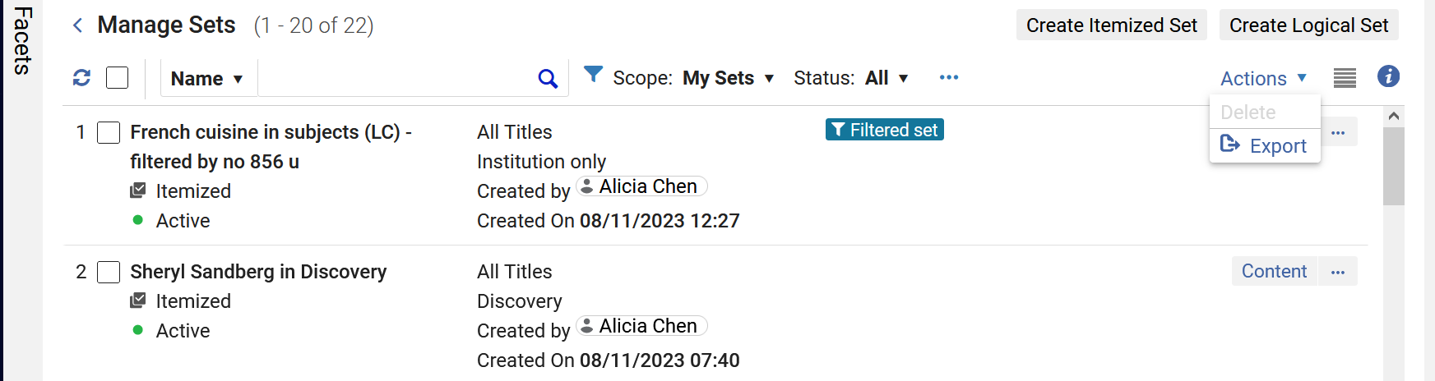
Responsiveness to screen size and resolution
As the resolution increases some of the actions move into the actions menu and can be accessed through the actions.
“Delete” and “Export” got combined in a separate “Actions” link

Slide 37
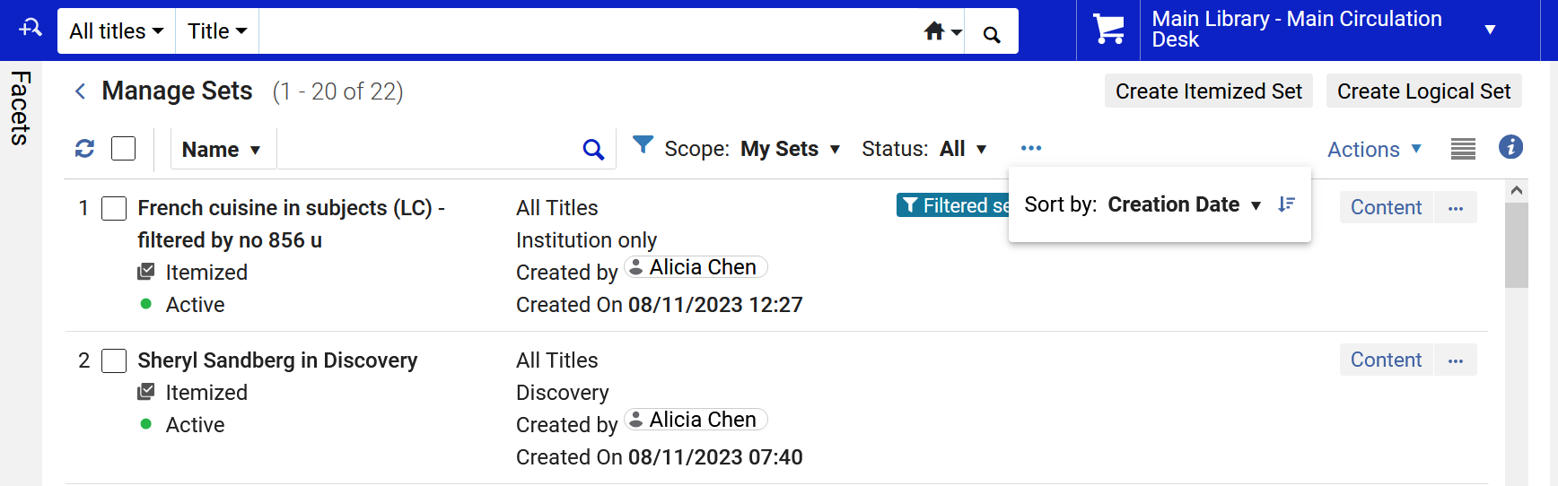
Responsiveness to screen size and resolution
As the resolution increases some of the actions can be accessed through the three dots menu.
“Sort by” is accessed from the three dots

Slide 38
Split View (Side-By-Side View)

Slide 39
Split View (Side-By-Side View)
To improve the usability of Manage Sets list of sets, a “Split View” (also called "Side-By-Side View“) presentation enables users to view a list of sets on one side and detailed information regarding the selected set on the other side.
The right panel holds detailed information regarding the set
This information is editable from the panel itself, preventing users from the need to navigate to a specific editing screen for the set.

Slide 40
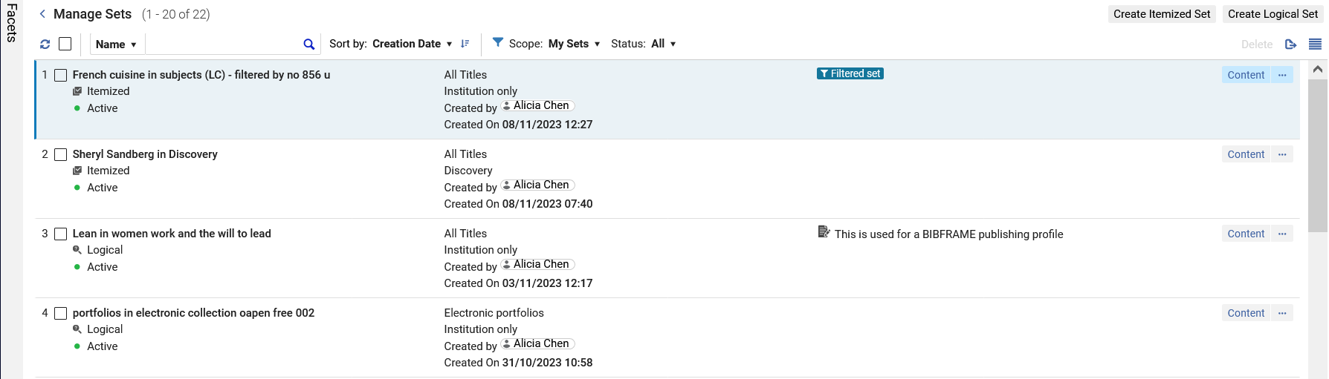
Split View (Side-By-Side View)
This is the list view. We will double-click a set to get to the Side-By-Side view.
We will double click “French cuisine in subjects (LC) - filtered by no 856 u”

Slide 41
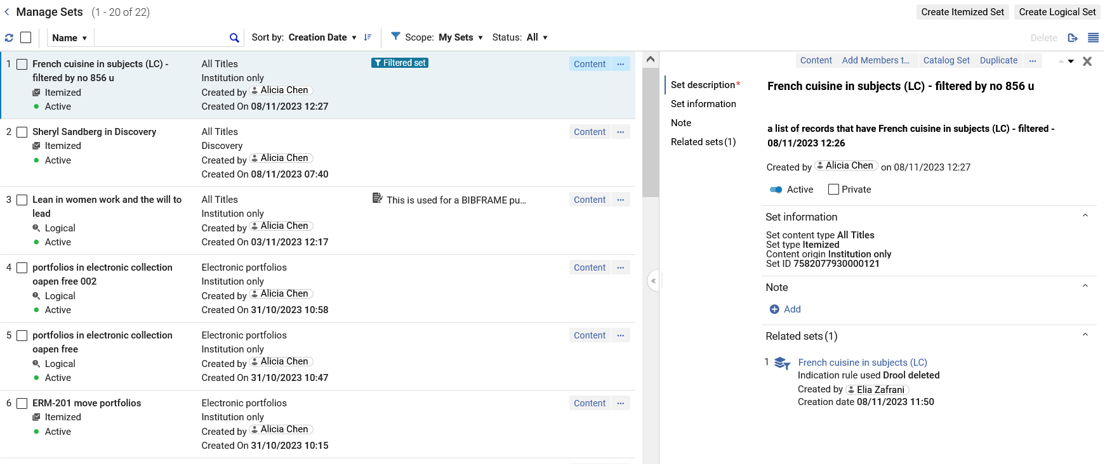
Split View (Side-By-Side View)
Select a set from the Compact left side record view
Editable set details will open in the Right side panel. For example, we can add a note and change the set to “Private”

Slide 42
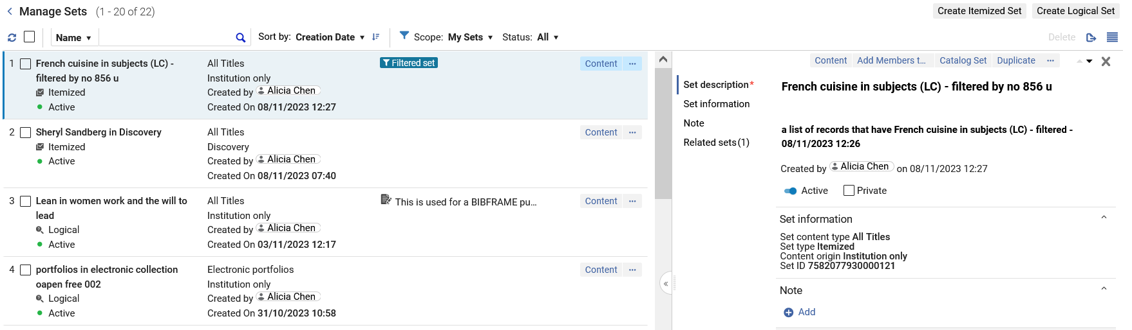
Split View (Side-By-Side View)
As the screen resolution changes, here too the display will change accordingly. Now in the low resolution we have four columns on the left.

Slide 43
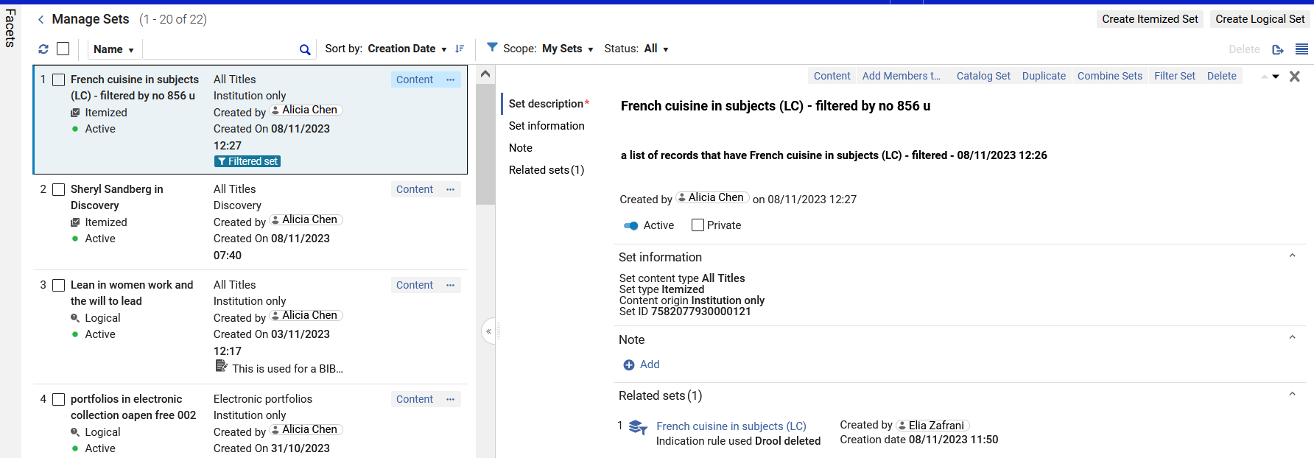
Split View (Side-By-Side View)
Here we have dragged the separation line between panes to the left, and not have less data on the left (three columns instead of four)
We dragged this to the left

Slide 44
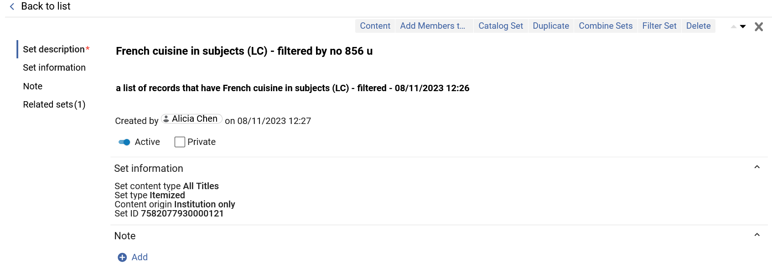
Split View (Side-By-Side View)
In a higher resolution we no longer have the columns in the left pane
In a higher resolution the set appears in full view instead of side-by-side view

Slide 45
Split View (Side-By-Side View)
In list view, full view and split view we can quickly take action on the set.
View content of the of the set
Delete the set
Add members to the set (for itemized sets
Filter the set with an indication rule
Push the set members to the metadata editor for editing
Navigate to different sections of the set
Duplicate the set
Combine the set with another set

Slide 46
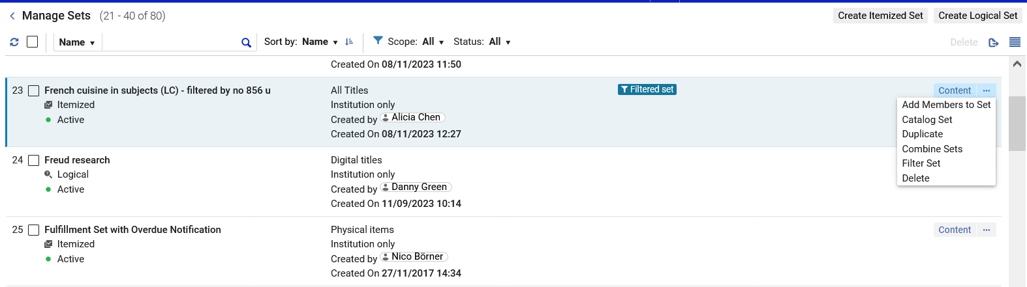
Split View (Side-By-Side View)
Here are the same actions as seen from the List View

Slide 47
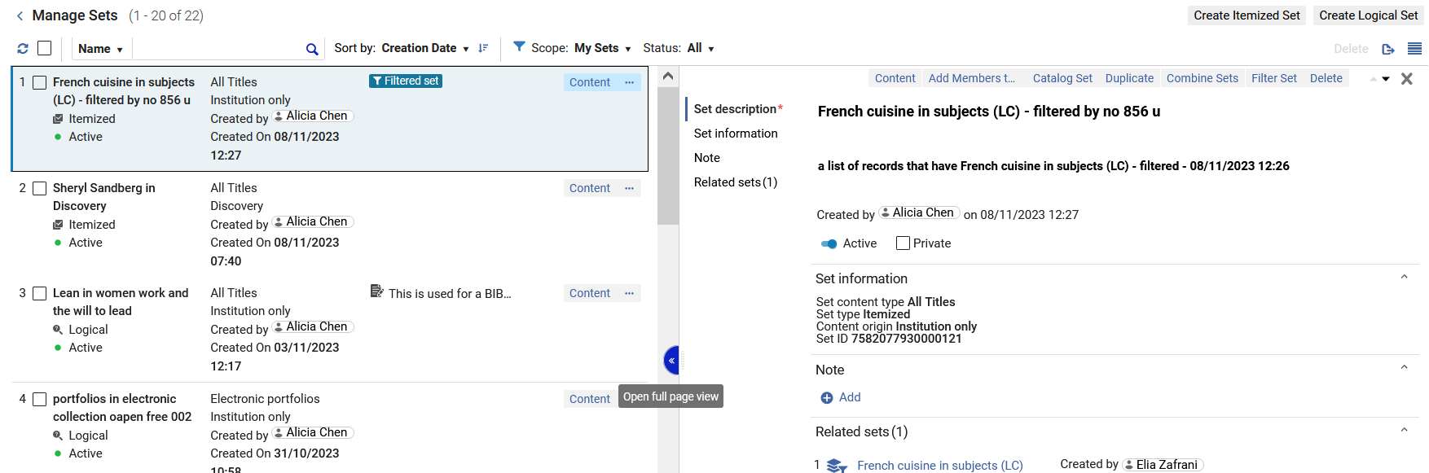
Split View (Side-By-Side View)
We can also switch between split view and full view via the link between the panes.

Slide 48
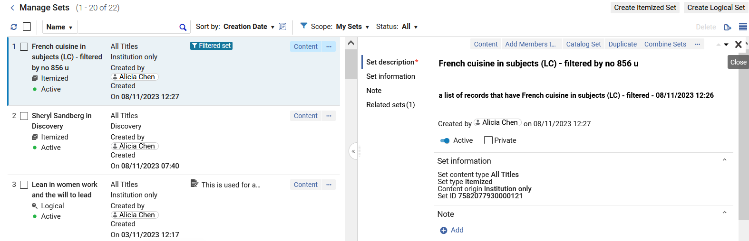
Split View (Side-By-Side View)
From the split view we can return to list view by closing the right panel.
Closing the right panel will return us to list view

Slide 49
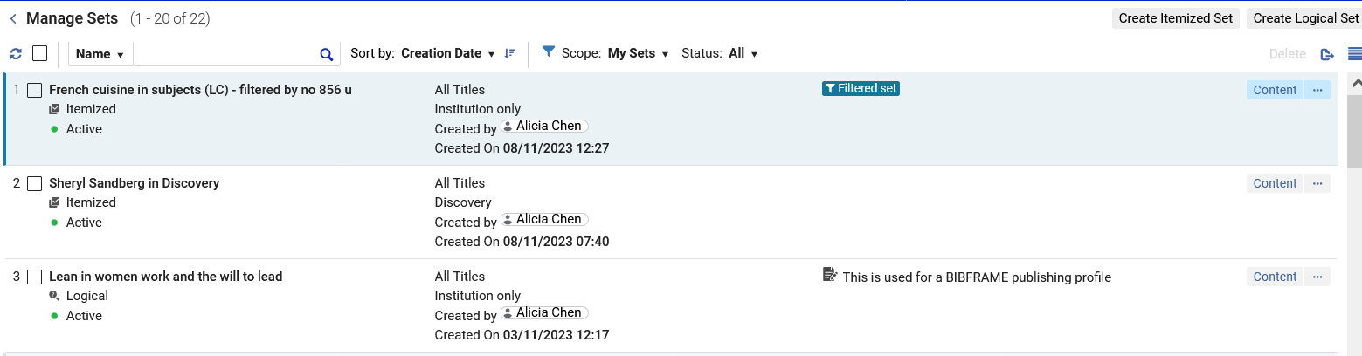
Split View (Side-By-Side View)
Now we are back in list view

Slide 50
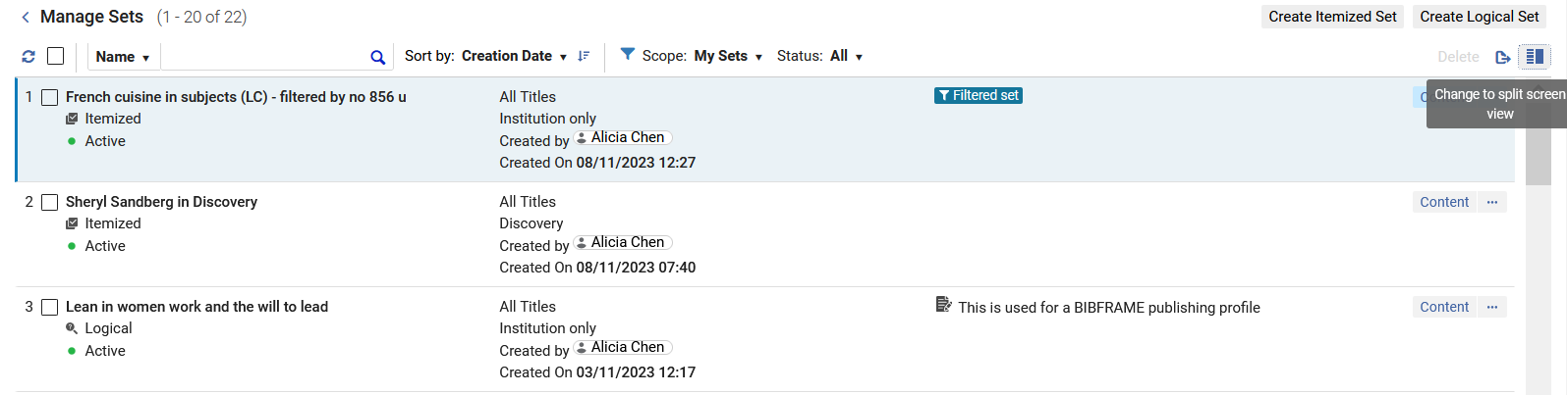
Split View (Side-By-Side View)
In our previous example we switched from list view to split view by double clicking a set from list view.
We could also have done this via the icon on the top right

Slide 51
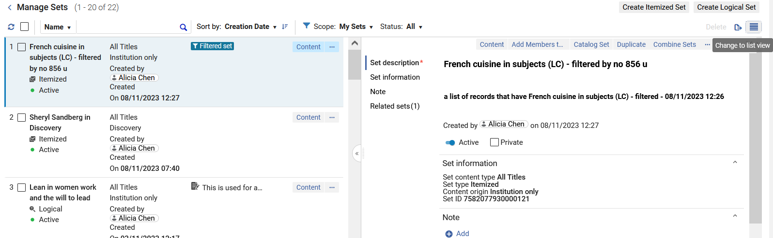
Split View (Side-By-Side View)
In our previous example we switched from split view to list view by clicking the x on the top right of the right pane, thereby closing the right pane.
We could also have done this via the icon on the top right

